Slide 1
Magnetic Effects of electric current
Chapter 13

Slide 2

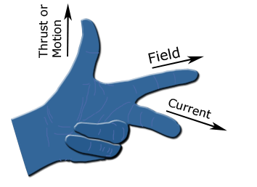
FORCE ON A CURRENT CARRYING CONDUCTOR IN A MAGNETIC FIELD .
Flemings left hand rule

Slide 3
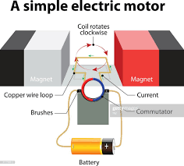
ELECTRIC MOTOR

Slide 4
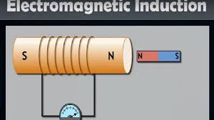
ELECTROMAGNETIC INDUCTION

Slide 5
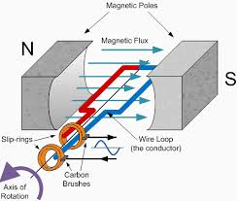
ELECTRIC GENERATOR

Slide 6
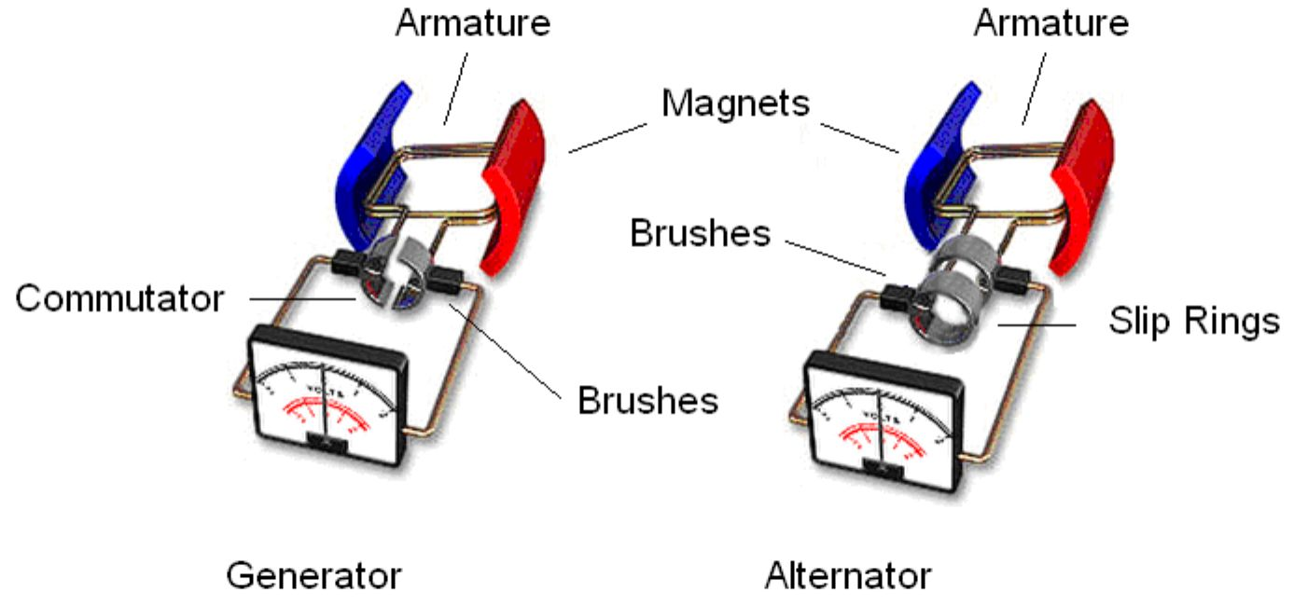
Types of Generators:
The generators are classified into types.
AC generators
DC generators

Slide 7
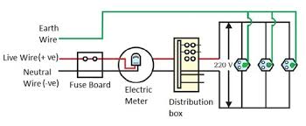
Domestic Electric Circuit

